Slide 1

Thermofluid Heating Pipe System
Students name:
Noor Mazen Abdulhadi 0229786 Deemah Mahmoud AlSayyed 0224017
Course: Thermal Sciences
Instructor: Mohammed Kilani

Slide 2
Contents
Abstract
Introduction
Device Design
Simulation
Operation
Results
Conclusion

Slide 3
Abstract
This project presents the modeling and simulation of a domestic hot water system, focusing on the heating process within a pipe through which water flows. A mathematical model capturing the heat transfer, fluid properties, and heat loss to the environment was developed. MATLAB's ODE solver was used to simulate transient temperature changes and system efficiency under varying conditions, including heater power and insulation presence. Results demonstrate the impact of insulation and flow rate on heating efficiency and outlet temperature, providing insights into system optimization..

Slide 4
Introduction
Thermal management is a critical factor in various engineering applications, especially in systems involving heat exchange between fluids and solid boundaries. The purpose of this project is to design and simulate a one-dimensional heating system in which a thermofluid is subjected to uniform external heat while flowing through a cylindrical pipe
The project primarily focuses on how the fluid temperature changes over time and space as it absorbs heat. We utilize MATLAB for analytical and numerical modeling and Simulink for dynamic system simulation. The model considers key parameters like fluid density, heat capacity, flow rate, and pipe geometry to evaluate system behavior.
This simulation is valuable for both educational and industrial purposes. It introduces students to the basic principles of thermodynamics and fluid mechanics while providing insights for future development of efficient thermal systems.

Slide 5
System Description
The system consists of a heated pipe section where water flows and is heated by an electric heater. The pipe is exposed to ambient conditions, causing heat losses. Key design parameters include pipe diameter and length, fluid properties, flow rate, and heater power. Insulation can be applied to reduce heat losses.
→ As the fluid flows through the pipe, it absorbs heat and its temperature rises. The simulation captures this change dynamically, allowing us to understand how various parameters affect the thermal behavior of the system.

Slide 6
The energy balance on the fluid in the pipe is modeled by considering heat input from the heater, convective heat losses to the environment, and heat carried away by the flowing fluid. The model assumes:
Fluid properties depend on the fluid type (e.g., water, oil, alcohol, mercury).
Heat loss to the environment is modeled by the equation: q _{loss} = h _{loss .} A .(T – T _{env} ) q _{loss :} is the rate of heat loss to the environment (W) h _{loss :} is the heat loss coefficient (W/m²·K)
_{A :} is the surface area of the pipe (m² )
_{T :} is the fluid temperature inside the pipe (°C)
T _{env :} is the ambient temperature (°C)

Slide 7

The governing differential equation for the fluid temperature T over time is given by:
dT/dt : is the rate of change of temperature with time (°C/s)
Q : is the heater power (W)
m . : is the mass flow rate of the fluid (kg/s)
C_{p} is the specific heat of the fluid (J/kg·K)
T_{in} is the inlet temperature (°C)
m is the mass of the fluid in the pipe (kg).

Slide 8
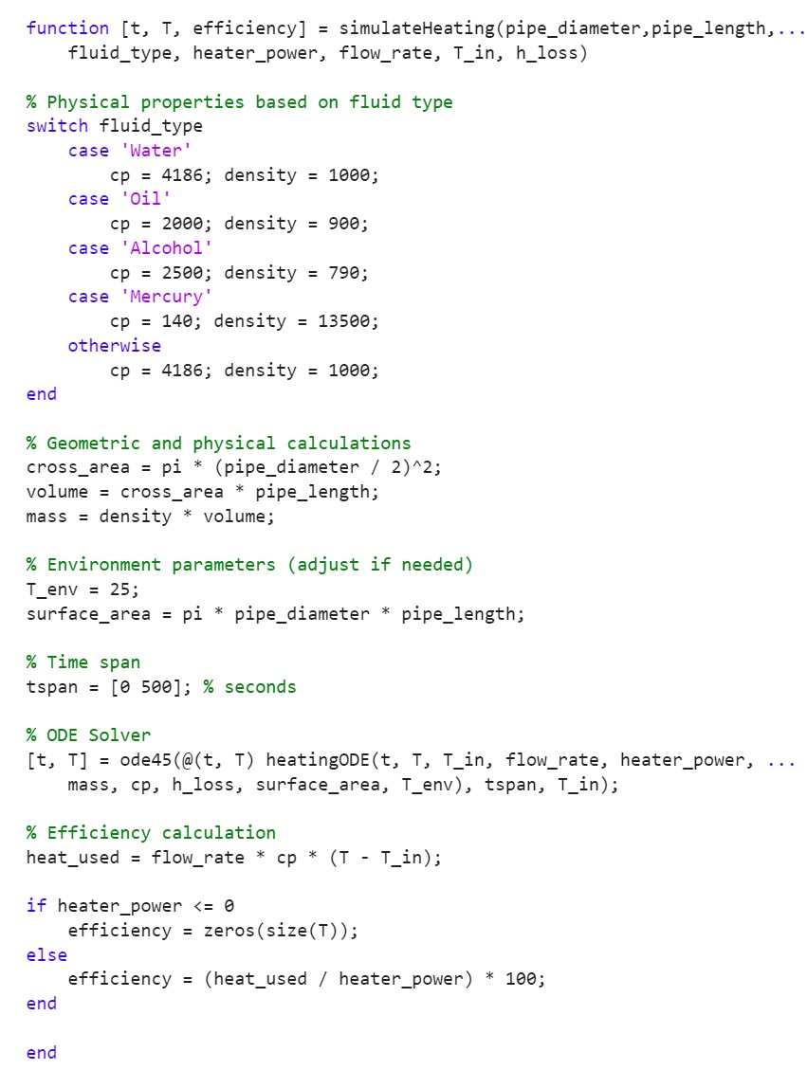
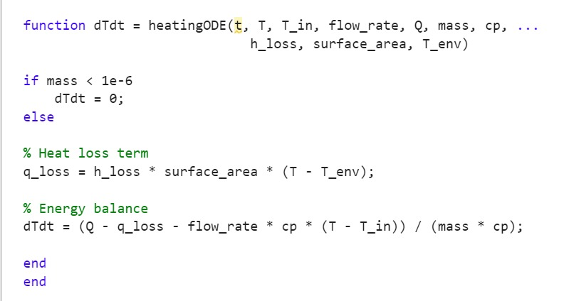

Slide 9
Simulation results confirm expected trends: * With heater ON and insulation applied (lower heat loss coefficient), the fluid temperature rises faster and reaches higher steady-state values. * Without insulation (higher heat loss), the temperature rise is slower and lower steady-state temperature is achieved. * Efficiency plots show corresponding improvements with insulation. * Flow rate affects temperature rise rate and outlet temperature due to thermal mass and residence time . These results align qualitatively with real-world expectations and literature, validating the model.

Slide 10
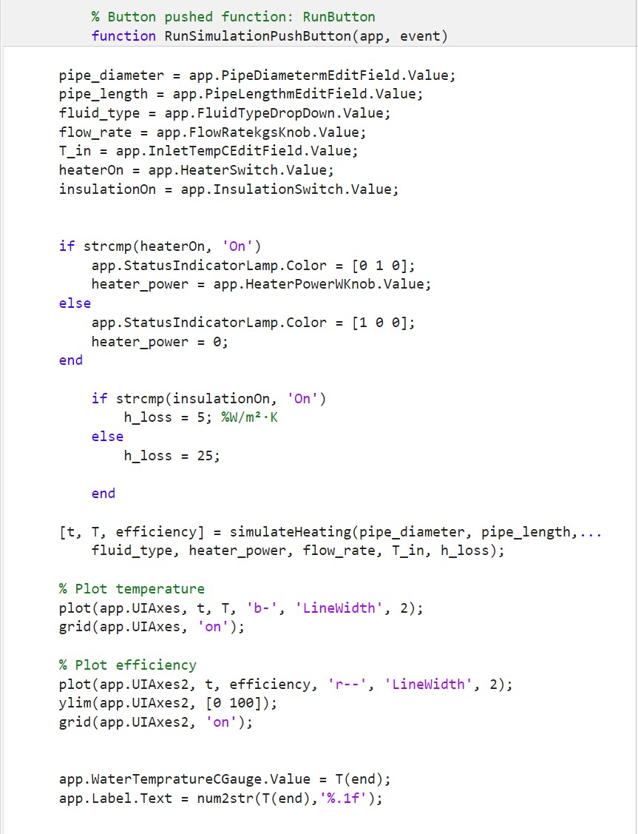
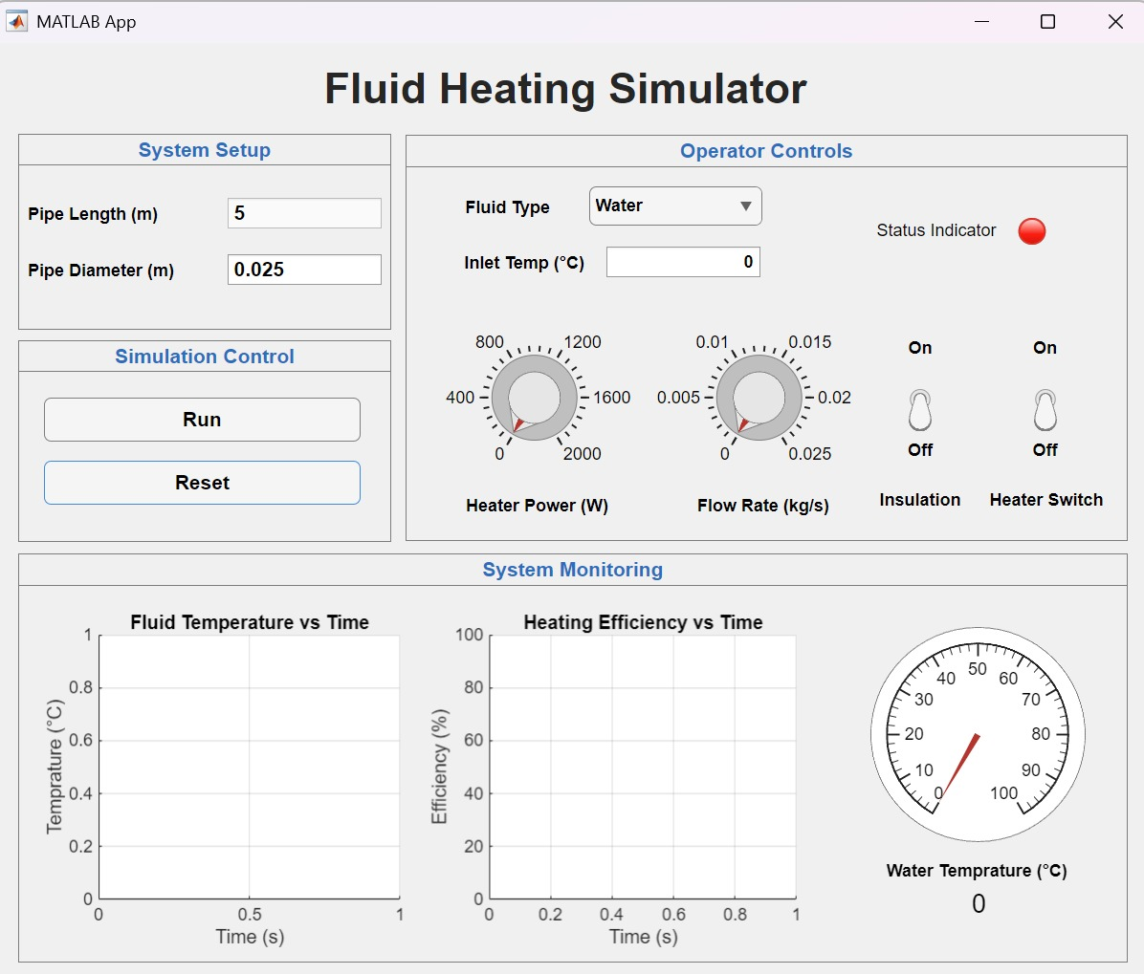

Slide 11
The model is implemented in MATLAB using the ode45 solver for time integration. Inputs include pipe dimensions, fluid type, heater power, flow rate, inlet temperature, and heat loss coefficient (variable depending on insulation). The simulation runs for 500 seconds to capture transient and steady-state behavior. Efficiency is computed as the ratio of heat gained by fluid to heater power input.
A MATLAB App was developed to allow interactive control of system parameters, including toggling the heater and insulation on/off, adjusting flow rate, and viewing temperature and efficiency plots. The system updates simulation results dynamically based on user inputs.

Slide 12
This project successfully developed and simulated a mathematical model of a domestic hot water system, incorporating heat transfer, fluid flow, and environmental heat loss. The model and MATLAB App provide a useful tool for exploring system behavior and optimizing design parameters such as insulation and flow rate for energy efficiency.

